Slide 1
UV- Visible Spectroscopy
Principle, instrumentation and application

Slide 2
Content
Introduction
Principle of UV-Visible spectroscopy
Types of electronic transitions
Absorption and intensity Shifts
Instrumentation
Applications
Limitations

Slide 3
Introduction
Absorption spectroscopy in which light of ultra violet (200-400nm) and visible region (400-700nm) is absorbed by the molecule.
Due to absorption of UV radiations the electrons situated in ground state get excited to high energy state.
The energy of UV radiation absorbed is as follows:
E = h v = hc/𝛌
The electrons undergo various
transitions. There are four types of
electronic transition.

Slide 4
types of transition
1. $σ$ →$σ\text{∗}$transitions
These transitions are of very high energy and occur in UV-region.
These transitions are shown by saturated hydrocarbon containing only $σ$-bonds like alkane.
2. n →$σ\text{∗}$transitions
These transitions are of low energy than $σ$ →$σ∗$ transitions.
They are shown by compounds containing oxygen, nitrogen, Sulphur and halogens.
Examples: Saturated halides,
alcohols,ethers, aldehyde, ketones,
and amines, etc.

Slide 5
3. $π$ →$π\text{∗}$transitions
These are of lower energy than n →$σ∗$transitions.
Examples: alkene, alkyne, carbonyl compounds.
4. $n$ →$π\text{∗}$transitions
These transitions are of lowest energy and are given by compounds having both non-bonding and $π$- electrons .
Examples: carbonyl, unsaturated carbonyl.
The order of energy- $σ$ →$σ$* > n- $σ$* > $π$- $π$* > n-$π$*

Slide 6
types of transition
1. $σ$ →$σ\text{∗}$transitions
These transitions are of very high energy and occur in UV-region.
These transitions are shown by saturated hydrocarbon containing only $σ$-bonds like alkane.
2. n →$σ\text{∗}$transitions
These transitions are of low energy than $σ$ →$σ∗$ transitions. They are shown by compounds containing oxygen, nitrogen, Sulphur and halogens.
Examples: Saturated halides,
alcohols,ethers, aldehyde, ketones,
and amines, etc.

Slide 7
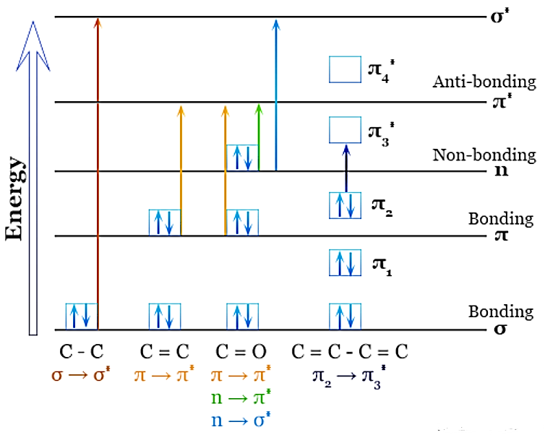
Types of transition

Slide 8
Concept of chromophore and auxochrome
Chromophore -
A covalently bonded unsaturated group responsible for electronic absorption is called chromophore or chromophoric group.
Examples: alkene, alkyne, carbonyl, nitro-compounds, thiocarbonyl, etc.
They exhibit absorption in UV and visible region. The color of a molecule is due to one or more such chromophoric groups.
They can be of two types:
Chromophores which contains πelectrons and undergo π- π* transitions. Examples: ethylene, acetylenes etc.
Chromophores which contains πelectrons and n electrons and undergo π-π* and n-π* transitions. Examples: carbonyls, nitriles, azo compounds etc.

Slide 9
Concept of chromophore and auxochrome
Chromophore -
A covalently bonded unsaturated group responsible for electronic absorption is called chromophore or chromophoric group.
Examples: alkene, alkyne, carbonyl, nitro-compounds, thiocarbonyl, etc.
They exhibit absorption in UV and visible region. The color of a molecule is due to one or more such chromophoric groups.
They can be of two types:
Chromophores which contains πelectrons and undergo π- π* transitions. Examples: ethylene, acetylenes etc.
Chromophores which contains
πelectrons and n electrons and
undergo π-π* and n-π*
transitions. Examples: carbonyls,
nitriles, azo compounds etc.

Slide 10
Auxochrome -
A saturated group with non-bonding electrons when attached to a chromophore changes both wavelength and the intensity of the absorption band is called an auxochrome.
It is also known as color- enhancing group.
Example: -OH, -OR, -NHR, -SH, -SR, -I, -Cl,-O-,-Br, etc.
The effect of the auxochrome is due to its ability to extend the conjugation of a chromophore by sharing of non- bonding electrons.
E.g.: benzene shows absorption
maximum at 255 nm while
aniline absorbs at 280 nm. Hence,
amino group is an auxochrome.

Slide 11
Absorption and intensity shifts
1. Bathochromic Shift / Red shift:
The shift of absorption to a longer wavelength due to substitution or change of solvent is called bathochromic shift. Also known as Red shift because the absorption maximum shifts towards red end.
Example: Benzene absorbs at 254nm while toluene absorbs at 261nm.
2. Hypsochromic shift / Blue shift:
The shift of absorption to a shorter wavelength due to removal of conjugation or change in polarity of the solvent is called Hypsochromic shift. Also known as Blue shift.
Examples: Aniline absorbs at 230nm in neutral solvent while it absorbs at 203nm in acidic medium.

Slide 12
Absorption and intensity shifts
1. Bathochromic Shift / Red shift:
The shift of absorption to a longer wavelength due to substitution or change of solvent is called bathochromic shift. Also known as Red shift because the absorption maximum shifts towards red end.
Example: Benzene absorbs at 254nm while toluene absorbs at 261nm.
2. Hypsochromic shift / Blue shift:
The shift of absorption to a shorter wavelength due to removal of conjugation or change in polarity of the solvent is called Hypsochromic shift. Also
known as Blue shift.
Examples: Aniline absorbs at 280nm
in neutral solvent while it absorbs at
230nm in acidic medium.

Slide 13
3. Hyperchromic shift:
When a substituent group causes increase in intensity of a band then the effect is called hyperchromic shift.
Example: The $∈$_{max} for benzene is 7400 while styrene has $∈$_{max} 14,000. Thus the substitution of vinyl
(-CH=CH₂) group in benzene causes hyperchromic shift.
4. Hypochromic shift:
When a particular substituent group decreases the intensity of absorption band then the effect is called hypochromic shift.
Example: The $∈$_{max} for benzene is 204
for B-band while chlorobenzene has
$∈$_{max} 190 for B-band. Thus substitution
of chloro group causes hypochromic shift.

Slide 14
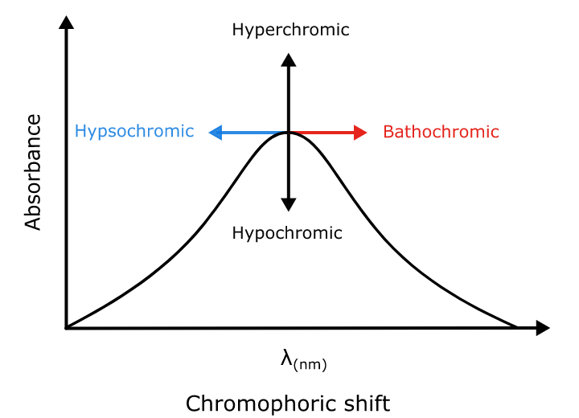
Absorption and intensity shifts

Slide 15
Principle
Beer Lambert’s Law- The Beer–Lambert law states that the absorbance of a solution is directly proportional to the concentration of the absorbing species in the solution and the path length.
A = $∈$cl
Here A= absorbance
$∈$= molar absorptivity or molar extinction coefficient (L mol⁻¹cm⁻¹ )
c = molar concentration of solute (mol L⁻¹ )
l = optical path length (cm)
Notes:
c

Slide 17
instrumentation
Figure: A schematic representation of UV-Visible spectroscopy

Slide 18
1. radiation source
For visible light tungsten or halogen lamp is used. For UV light deuterium lamp is used. The intensity of tungsten lamp is 375nm and of hydrogen-deuterium lamp is below 375nm.

Slide 19
2. WAVELENGTH SELECTION
The next step is to select the specific wavelength of light suitable to the particular type of sample. For this there are some methods;
Monochromator-
It separate the light into a small band of wavelength.
It is made of prisms and slits.
The various wavelengths of source light are separated by prism and then
selected by slits.Monochromator are most famous for this purpose because
of their flexibility.

Slide 20
3. Sample and reference cells
One of the selected wavelengths passed through the sample solution and the second one pass through the reference solution.
Both sample and reference solution contained in the cells.
These cells are known as cuvette and made of silica or quartz.

Slide 21
4. Detector
The purpose of detector is served by two photocells.
One photocell receive the beam from sample cell and the other one from reference.
The intensity of radiation from reference cell is stronger than the sample cell. This results in the generation of
pulsating or alternating
currents in the photocell.

Slide 22
5. Amplifier
The alternating current generated in the photocells is transferred to amplifier.
The current generated in the photocells is of very low intensity.
The main purpose of the amplifier is to amplify the signals many times so we can get clear and recordable signals.

Slide 23
6. Recording devices
The amplifier is coupled to a pen recorder which is connected to the computer.
The computer stores all the data generated and produces the spectrum of the desired compound.

Slide 24
Applications of UV-Vis spectroscopy
1. Detection of impurities
It is one of the best methods for the determination of impurities in organic molecule.
Additional peaks can be observed due to impurities in the sample and it can be compared with known standard raw material.
The impurities can be
detected by measuring
the absorbance at specific
wavelength.

Slide 25
Applications of UV-Vis spectroscopy
2. Structure elucidation-
UV-visible spectroscopy can be used for the quantitative determination of compounds that absorb UV radiation.
It helps to characterize the compounds that absorb UV radiations. Identification is done by comparing the absorption spectra of known compound.
This technique is used to detect the presence / absence of a functional group in the sample compound.
UV-visible spectroscopy helps to study
the kinetics of reaction.
Molecular weight of the compound
can be measured by UV- visible spectroscopy.

Slide 26
Applications of UV-Vis spectroscopy
3. DNA and RNA analysis -
This spectroscopy helps to check the purity and amount of DNA and RNA.
4. Pharmaceutical analysis –
It is the most popular application of UV-visible spectroscopy.

Slide 27
Limitations of uv-visible spectroscopy
Stray lights- The wavelength selectors are not 100 % accurate. Tiny amount of light can be transmitted by the light source.
Light scattering – Suspended solids in liquid sample can cause light scattering. Bubbles in cuvette can scatter light.
Interference from multiple absorbing species- A sample might include, for instance, several types of blue-green pigment called chlorophyll. The various chlorophylls show overlapping spectra when studied in the same sample.
Geometrical consideration – The misaligned placement of any of the instruments’
components, particularly the cuvette
that holds the sample, can result in
unreproducible results and may be
inaccurate.

